Slide 1
Chapter 3
Transform-Domain Representation of
Discrete-Time Signals

Slide 2
Main Contents
Spectrum of Discrete Non- periodical
Time Sequence ------Discrete Time Fourier Transform (DTFT)
Spectrum of Discrete Periodical Time Sequence---Discrete Time Fourier Transform (DFT)
Fast Computation Algorithm of DFT----Fast Fourier Transform (FFT)

Slide 3
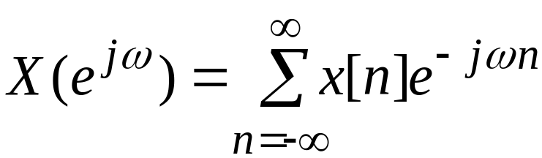

§3.1 Discrete-Time Fourier Transform
Definition - The discrete-time Fourier transform (DTFT) X(e^{jω}) of a sequence x[n] is given by
In general, X(e^{jω}) is a complex function of the real variable ω and can be written as
X(e^{jω}) = X_{re}(e^{jω}) + j X_{im}(e^{jω})

Slide 4
§3.1 Discrete-Time Fourier Transform
The DTFT X(e^{jω}) of a sequence x[n] is a continuous function of ω
It is also a periodic function of ω with a period 2π:
X_{re}(e^{jω}) and X_{im}(e^{jω}) are, respectively, the real and imaginary parts of X(e^{jω}) , and are real functions of ω

Slide 5
§3.1 Discrete-Time Fourier Transform
X(e^{jω}) can alternately be expressed as
X(e^{jω}) = | X(e^{jω}) |e^{jθ(ω)}
where
θ(ω) = arg{X(e^{jω}) } , odd functions of ω
even functions of w

Slide 6
§3.1 Discrete-Time Fourier Transform
| X(e^{jω}) | is called the magnitude function
θ(ω) is called the phase function
Both quantities are again real functions of ω
In many applications, the DTFT is called the Fourier spectrum
Likewise, | X(e^{jω}) | and θ(ω) are called the magnitude and phase spectra

Slide 7
§3.1 Discrete-Time Fourier Transform
Note: X(e^{jω}) = | X(e^{jω}) |e^{jθ(ω+2πk)}
= | X(e^{jω}) |e^{jθ(ω)}
for any integer k
The phase function θ(ω) cannot be uniquely specified for any DTFT
Unless otherwise stated, we shall assume that the phase function θ(ω) is restricted to the following range of values:
-π≤ θ(ω) ≤ π
called the principal value.

Slide 8
§3.1 Discrete-Time Fourier Transform
The DTFTs of some sequences exhibit discontinuities of 2π in their phase responses
An alternate type of phase function that is a continuous function of ω is often used
It is derived from the original phase function by removing the discontinuities of 2π

Slide 9
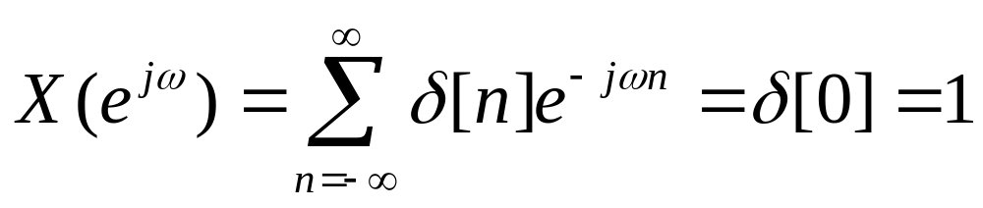
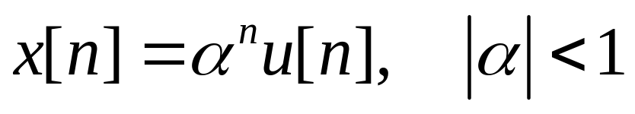
§3.1 Discrete-Time Fourier Transform
Example - The DTFT of the unit sample sequence δ[n] is given by
Example - Consider the causal sequence

Slide 10
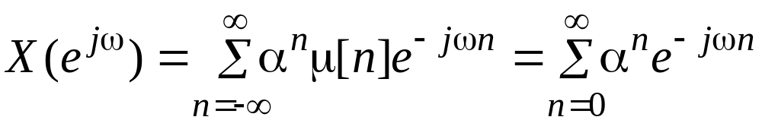
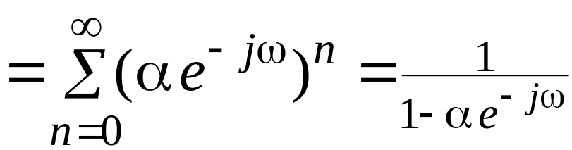
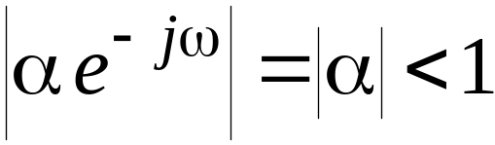
§3.1 Discrete-Time Fourier Transform
Its DTFT is given by
as

Slide 11
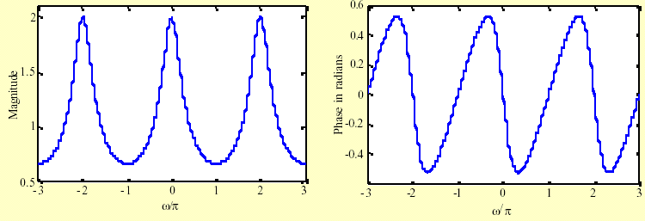
§3.1 Discrete-Time Fourier Transform
The magnitude and phase of the DTFT X(e^{jω}) = 1/(1 – 0.5e^{-jω}) are shown below

Slide 12
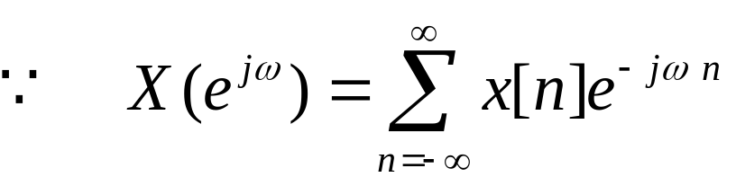
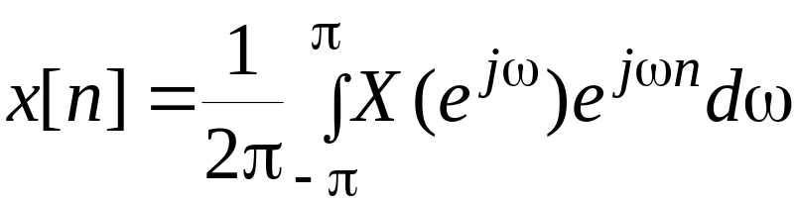
§3.1 Inverse Discrete-Time Fourier Transform
represents the Fourier series representation of the periodic function
As a result, the Fourier coefficients x[n] can be computed from X(e^{jω}) using the Fourier integral
This formular is called Inverse discrete-time
Fourier transform

Slide 13

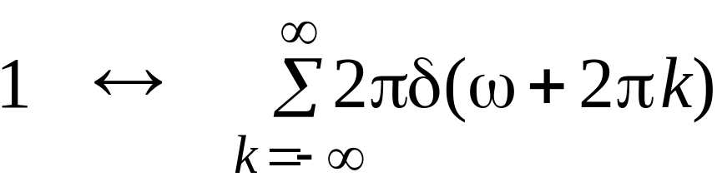
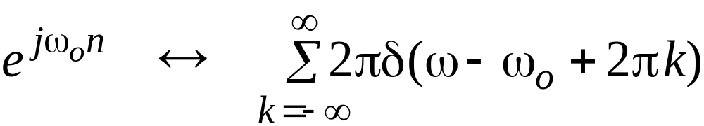
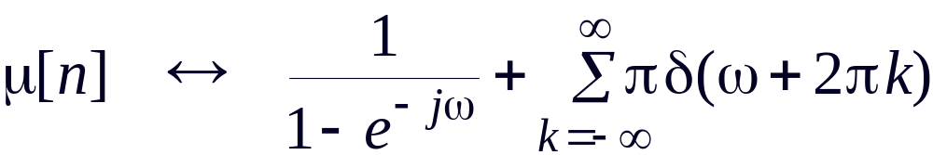
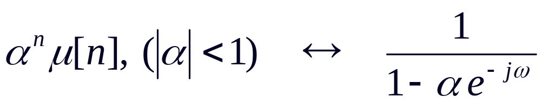
Commonly Used DTFT Pairs
  Sequence DTFT

Slide 14
§3.2 DTFT Properties
There are a number of important properties of the DTFT that are useful in signal processing applications
These are listed here without proof
Their proofs are quite straightforward
We illustrate the applications of some of the DTFT properties

Slide 15
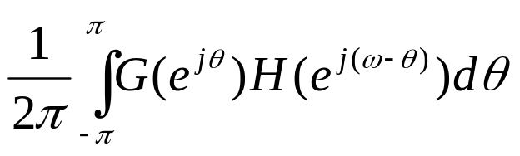
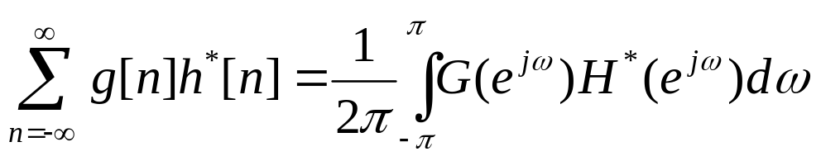
§3.2 DTFT Properties
Type of Property Sequence DTFT
g[n] G(e^{jω})
h[n] H(e^{jω})
Linearity ag[n]+bh[n] aG(e^{jω})+bH(e^{jω})
Time-shifting g[n-n₀] e^{-jωn0}G(e^{jω})
Frequency-shifting e^{-jω0n}g[n] G(e^{j(ω- ω0)})
Differentiation ng[n] jdG(e^{jω})/dω
Convolution g[n]*h[n] G(e^{jω})H(e^{jω})
Modulation g[n]h[n]
Parseval’s relation

Slide 16
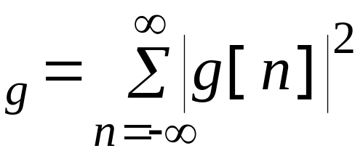
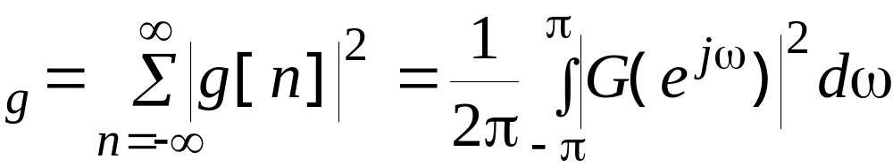
§3.2 DTFT Properties
The total energy of a finite-energy sequence g[n] is given by
E
From Parseval’s relation we observe that
E

Slide 17
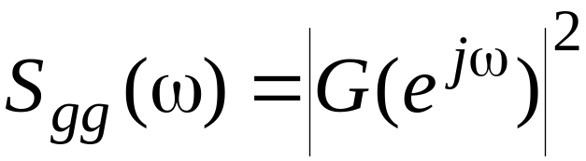
Energy Density Spectrum
The quantity
is called the energy density spectrum
The area under this curve in the range -π≤ω≤π divided by 2π is the energy of the sequence

Slide 18
§3.3 Discrete Fourier Transform (DFT)
DTFT is the Fourier Transform of discrete-time sequence. It is discrete in time domain and its spectrum is periodical, but continue which cannot be processed by computer which could only process digital signals in both sides, that means the signals in both sides must be both discrete and periodical.

Slide 19
§3.3 Discrete Fourier Transform (DFT)
Time domain Frequency domain
Continue aperiodical ← FT → Aperiodical continue
Continue periodical ← FST → Aperiodical discrete
Discrete aperiodical ← DTFT → periodical continue
Discrete periodical ← DFT → periodical discrete
(DFS)

Slide 20

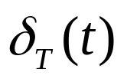

Typical FT Pair
ω₀ = 2π/T
←→
-2T
-T
0
T
2T
t
-2ω₀
- ω₀
0
ω₀
2ω₀
ω
In DFT, the signals in both sides are discrete, so it is the only transform pair which can be processed by computer.
The signals in both sides are periodical, so the processing could be in one period, which is important because (1) the number of calculation is limited, which is necessary for computer; (2) all of the signal information could be kept in one period, which is necessary for accurate processing.

Slide 21
Make a signal discrete and periodical
The engineering signals are often continue and a periodical. If we want to process the signals with DFT, we have to make the signals discrete and periodical.
Sampling to make the signal discrete
Make the signal periodical:
If x[n] is a limited length N-point sequence, see it as one period of a periodical signal that means extend it to a periodical
If x[n] is an infinite length sequence, cut-off its tail to make a N-point sequence, then do the periodic extending. The tail cutting-off will introduce distortion. We must develop truncation(截断) algorithm to reduce the error, which is windowing.

Slide 22


Make a signal discrete and periodical
x(t)
X(jω)
FT
P(t)
P(jω)
…
…
ω₀=2π/T_{s}
T_{s}
ω₀
x[nT]
X(jω)
DTFT
q(t)
Q(jω)
Q(jω)
…
…
…
…
Ω₀= 2π/T
Ω₀= 2π/T
T
Ω₀
Ω₀
DFT and DFS

Slide 23
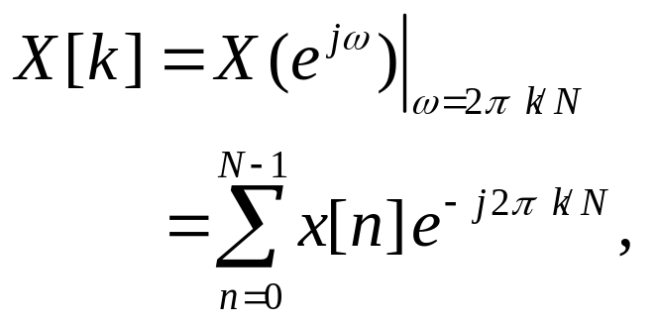

§3.3 Discrete Fourier Transform (DFT)
Definition - The simplest relation between a length-N sequence x[n], defined for 0≤n ≤N-1, and its DTFT X(e^{jω}) is obtained by uniformly sampling X(e^{jω}) on the ω-axis between 0≤ω ≤2π at ω_{k}=2πk/N , 0≤k≤N-1
From the definition of the DTFT have

Slide 24
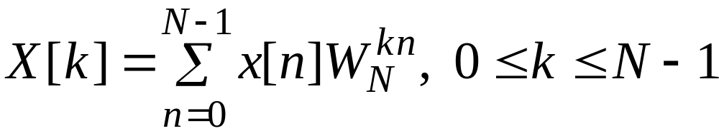
§3.3 Discrete Fourier Transform (DFT)
Note: X[k] is also a length-N sequence in the frequency domain
X[k] is called the Discrete Fourier transform (DFT) of the sequence x[n]
Using the notation W_{N}=e^{-j2 π/N} the DFT is usually expressed as:

Slide 25
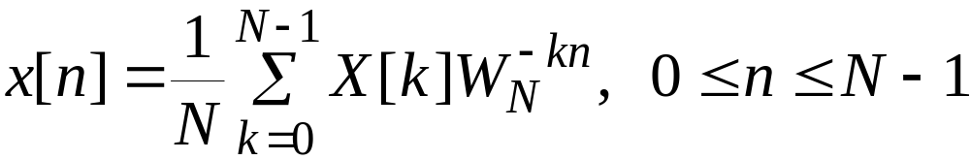
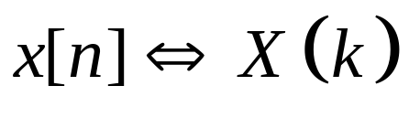
§3.3 Discrete Fourier Transform (DFT)
The inverse discrete Fourier transform (IDFT) is given by
DFT pairs:
DFT is the discrete spectra representation of discrete time signal!

Slide 26
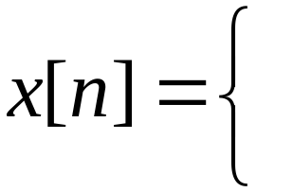
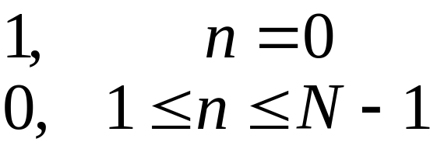
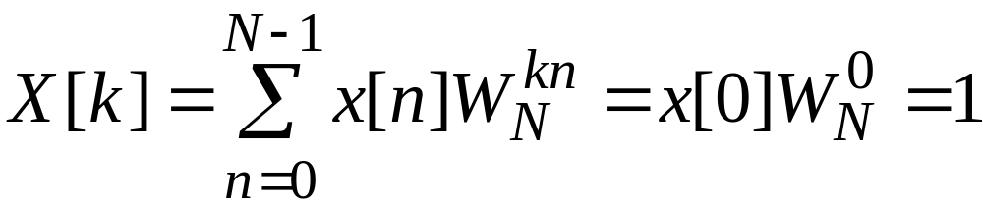

§3.3 Discrete Fourier Transform (DFT)
Example - Consider the length-N sequence
Its N-point DFT is given by

Slide 27
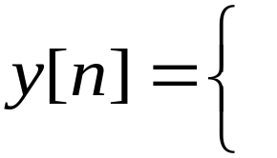
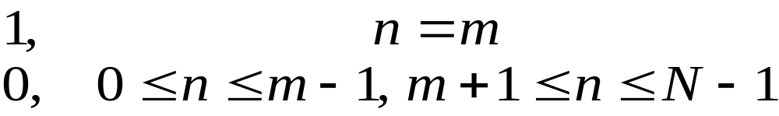
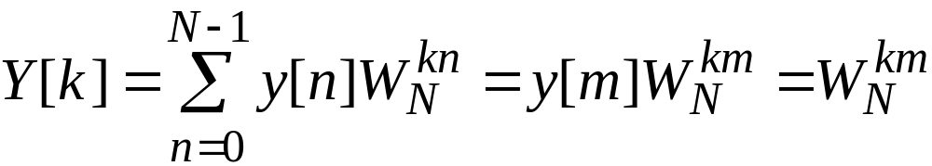
§3.3 Discrete Fourier Transform (DFT)
Example - Consider the length-N sequence
Its N-point DFT is given by

Slide 28
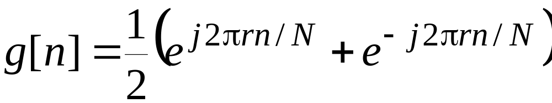
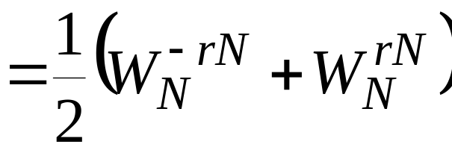
§3.3 Discrete Fourier Transform (DFT)
Example - Consider the length-N sequence defined for 0 ≤n ≤N-1
Using a trigonometric identity we can write

Slide 29
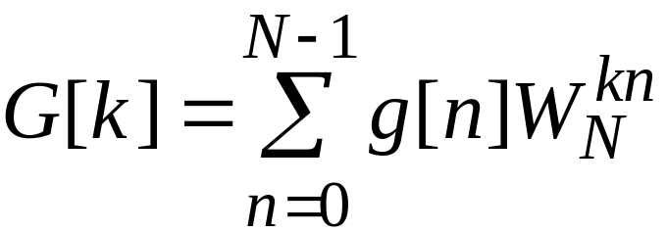
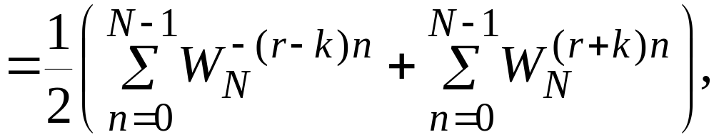
§3.3 Discrete Fourier Transform (DFT)
The N-point DFT of g[n] is thus given by

Slide 30
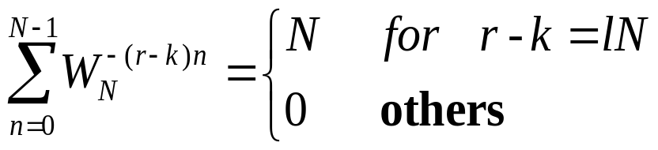
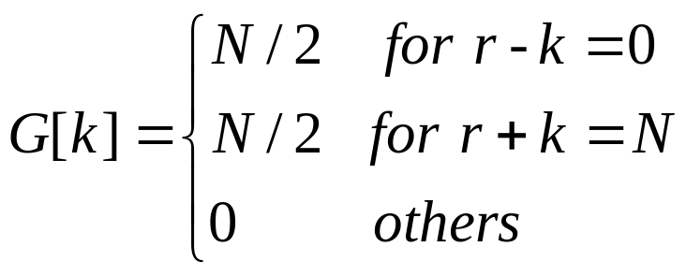

§3.3 Discrete Fourier Transform (DFT)
Making use of the identity
l: an integer
we get

Slide 31
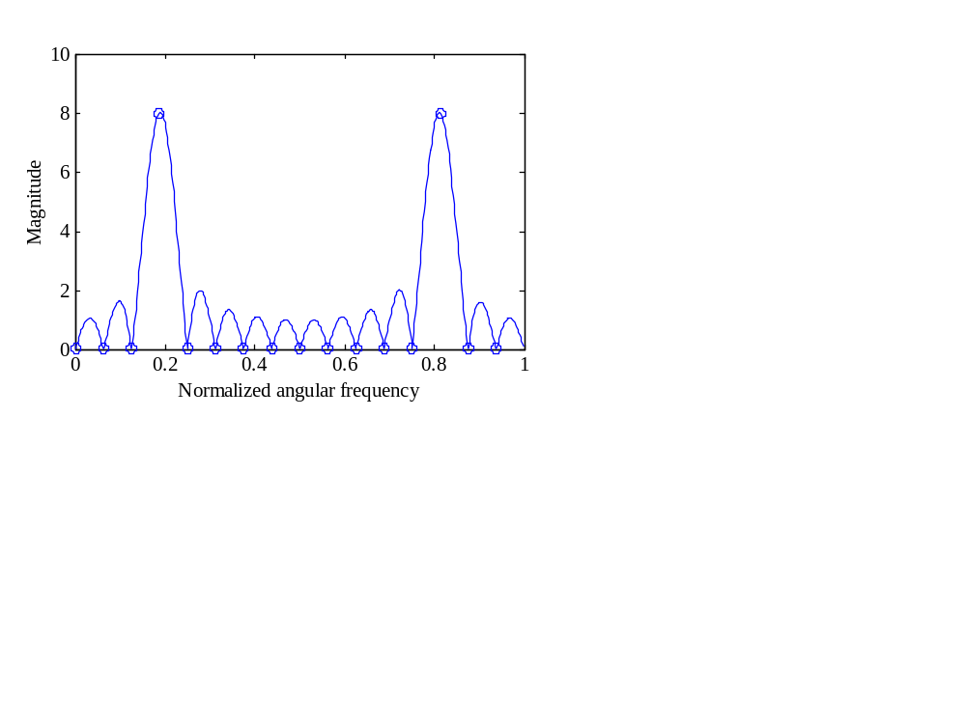
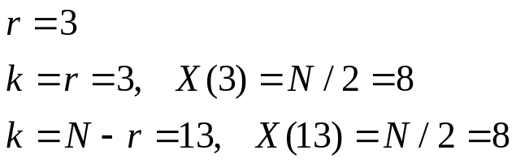
Example -
as shown below
indicates DFT samples

Slide 32
§3.4 DFT Properties
Like the DTFT, the DFT also satisfies a number of properties that are useful in signal processing applications
Some of these properties are essentially identical to those of the DTFT, while some others are somewhat different
A summary of the DFT properties are given in tables in the following slides

Slide 33
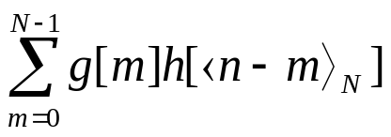
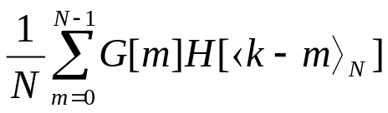
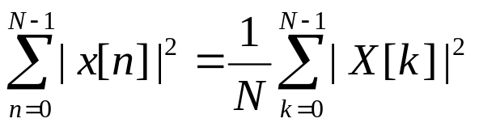
§3.4 DFT Properties
Type of Property length-N sequence N-point DFT
g[n] G[k]
h[n] H[k]
Linearity ag[n]+bh[n] aG[k]+bH[k]
Circular Time-shifting g[⟨n-n₀⟩_{N}] W_{N}^{kn0}G[k]
Frequency-shifting W_{N}^{-kn0}g[n] G[⟨k-k₀⟩_{N}]
Duality G[n] N[g⟨-k⟩_{N}]
Circular Convolution
G[k]H[k]
Modulation g[n]h[n]
Parseval’s relation

Slide 34


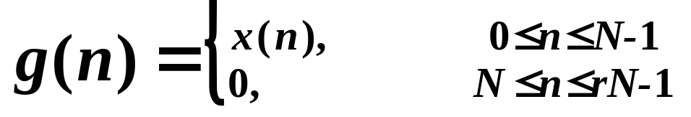
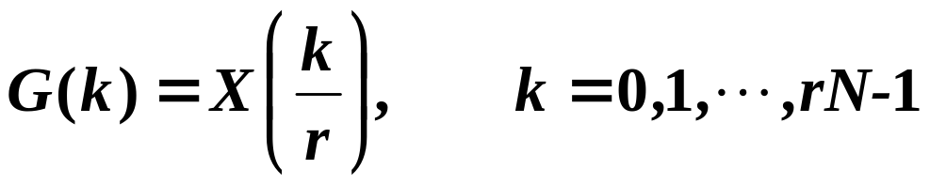
§3.4 DFT Properties
Zero-padding:

Slide 35
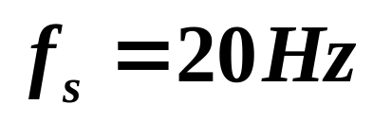
Example:
N=16

Slide 36
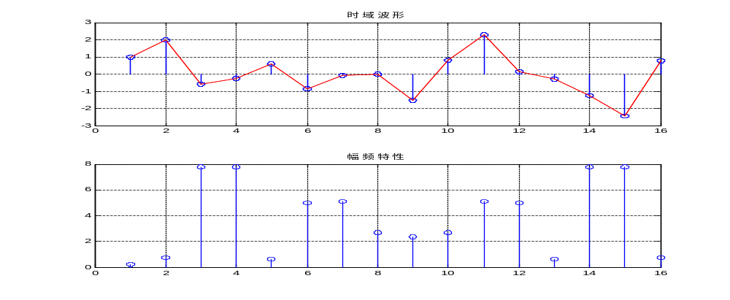
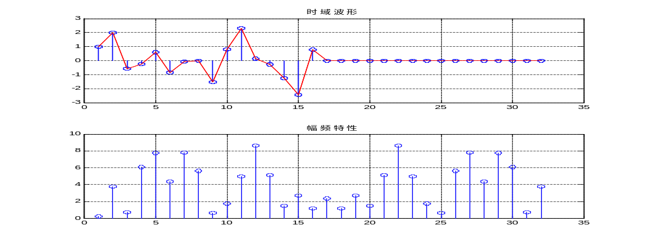
N=16
N=32

Slide 37
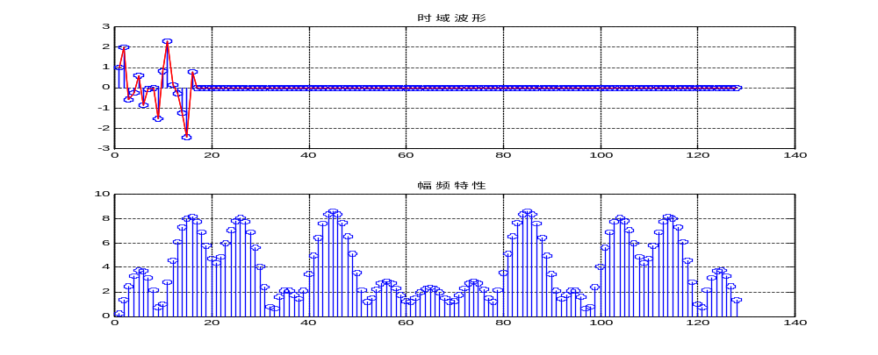
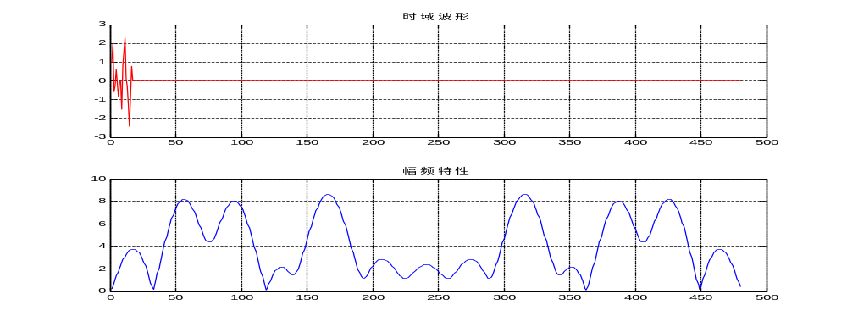
N=16*7
N=16*29

Slide 38
Effect induced in DFT:
Spectrum Aliasing
Spectrum leaking
Fence effect

Slide 39
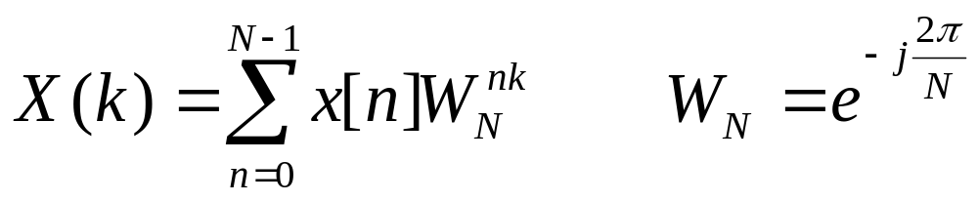
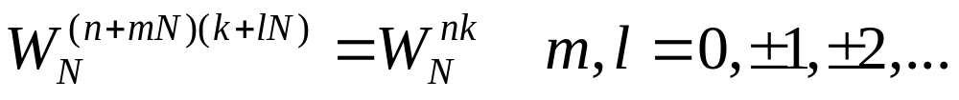
§3.4 Discrete Fourier Transform Computation
---Fast Fourier Transform(FFT)
The definition of DFT:
Direct computation of the N-point DFT requires:
N² complex multiplications
N(N-1) =N²-N≈N² complex additions

Slide 40
Consider a sequence x[n] of length N=2^{k}
Split N-point sequence into two N/2-point sequences
x₀[n] = x[2n]
x₁[n] = x[2n+1]

Slide 41
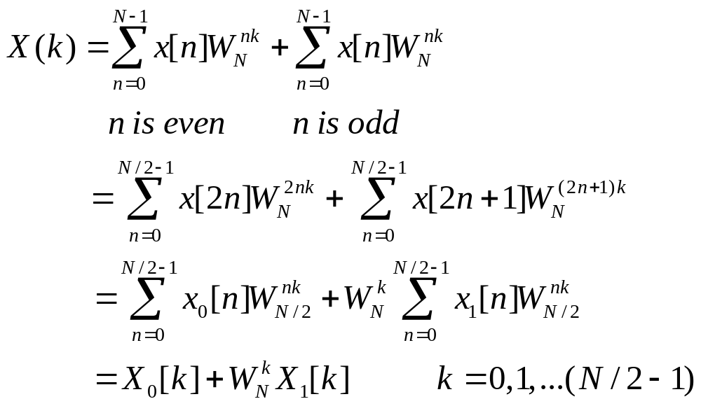
Split N-point sequence into two N/2-point sequences

Slide 42

Split N-point sequence into two N/2-point sequences
The last step of above equation comes from

Slide 43
Split N-point sequence into two N/2-point sequences
We already divided the N-point DFT into two N/2-point DFT
There are N-point in X(k), but there are only N/2-point both in X₀(k) and X₁(k), so we got only first half N/2-point result of X(k)

Slide 44


Split N-point sequence into two N/2-point sequences
With the second half N/2-point result of X(k), we have
Because

Slide 45







Split N-point sequence into two N/2-point sequences
Butterfly flowchart:
firstN/2
points
secondN/2
points

Slide 46


Split N-point sequence into two N/2-point sequences
we arrive at the N-point DFT of x[n]:
where X₀[k] and X₁[k] are the (N/2)-point DFTs of the (N/2)-length sequences x₀[n] and x₁[n]
we need only calculate the X₀(k) and X₁(k) in the range [0, N/2-1], and it is conveniently to calculate the X(k) in range [0, N-1], which will greatly reduce the computation.

Slide 47








Decimation-in-Time FFT Algorithm
Block-diagram interpretation
x[n]
x₀[n]=x[2n]
↓2
x[n]
x[n+1]
x₁[n]=x[2n+1]
z
↓2
N/2-point
DFT
↓2
z
N/2-point
DFT
↓2

Slide 48




Decimation-in-Time FFT Algorithm

Slide 49

Decimation-in-Time FFT Algorithm
Flow-graph representation, N=8

Slide 50
Decimation-in-Time FFT Algorithm
the modified scheme requires (N²/2+N/2)complex multiplications [N(N/2-1)+N ]= N²/2 complex additions
Direct computation of the N-point DFT :
N² complex multiplications
N(N-1) =N²-N≈N² complex additions

Slide 51

Decimation-in-Time FFT Algorithm
For N≥3, (N²/2)+N <N²
Continuing the process we can express X₀[k] and X₁[k] as a weighted combination of two (N/4)-point DFTs
For example, we can write
where X₀₀[k] and X₀₁[k] are the (N/4)-point DFTs of the (N/4)-length sequences
x₀₀[n]= x₀[2n] and x₀₁[n]= x₀[2n+1]

Slide 52
Decimation-in-Time FFT Algorithm
Likewise, we can express
where X₁₀[k] and X₁₁[k] are the (N/4)-point DFTs of the (N/4)-length sequences x₁₀[n] = x₁[2n] and x₁₁[n] = x₁[2n+1]

Slide 53
















Decimation-in-Time FFT Algorithm
Block-diagram representation of the two-stage algorithm
↓2
↓2
z
↓2
z
↓2
↓2
z
↓2

Slide 54
Decimation-in-Time FFT Algorithm
The following figure shows the time domain decomposition used in the FFT
1 signal of 8 points
0 1 2 3 4 5 6 7
2 signals of 4 points
0 2 4 6
1 3 5 7
4 signals of 2 points
0 4
2 6
1 5
3 7

Slide 55

Decimation-in-Time FFT Algorithm
Flow-graph representation

Slide 56

Decimation-in-Time FFT Algorithm
In the flow-graph shown N =8
Hence, the (N/4)-point DFT here is a 2-point DFT and no further decomposition is possible
The four 2-point DFTs, X_{ij}[k], i,j=0,1 can be easily computed
For example

Slide 57


Decimation-in-Time FFT Algorithm
Corresponding flow-graph of the 2-point DFT is shown below obtained using the identity

Slide 58

Decimation-in-Time FFT Algorithm
Complete flow-graph of the 8-point DFT is shown below

Slide 59
Decimation-in-Time FFT Algorithm
The flow-graph consists of 3 stages
First stage computes the four 2-point DFTs
Second stage computes the two 4-point DFTs
Last stage computes the desired 8-point DFT
The number of complex multiplications and additions at each stage is equal to 8, the size of the DFT

Slide 60
Decimation-in-Time FFT Algorithm
Total number of complex multiplications and additions to compute all 8 DFT samples is equal to 8 + 8 + 8 = 24 = 8×3(respectively)
In the general case when N=2^{k} , number of stages for the computation of the (2^{k} )-point DFT in the fast algorithm will be k=log₂N
Total number of complex multiplications
additions to compute all N DFT samples is N( log₂N)(respectively)

Slide 61



Decimation-in-Time FFT Algorithm
In developing the count, multiplications with and have been assumed to be complex
We have not taken advantage of the symmetry property
These properties can be exploited to reduce the computational complexity further

Slide 62
Decimation-in-Time FFT Algorithm
Examination of the flow-graph
reveals that each stage of the DFT computation process employs the same basic computational module which is called a butterfly computation

Slide 63

Decimation-in-Time FFT Algorithm

Slide 64

Direct
computation
FFT

Slide 65
Decimation-in-Time FFT Algorithm
The DFT computation algorithm described here also is efficient with regard to memory requirements
At the end of computation at any stage, output variables can be stored in the same registers previously occupied by the corresponding input variables
This type of memory location sharing is called in-place computation resulting in significant savings in overall memory requirements

Slide 66

Decimation-in-Time FFT Algorithm
In the DFT computation scheme outlined, the DFT samples X[k] appear at the output in a sequential order while the input samples x[n] appear in a different order

Slide 67
Decimation-in-Time FFT Algorithm
Thus, a sequentially ordered input x[n] must be reordered appropriately before the fast algorithm described by this structure can be implemented
To understand the input reordering scheme represent the arguments of input samples x[n] and their sequentially ordered new representations in binary forms

Slide 68
Decimation-in-Time FFT Algorithm
The relations between the arguments m and n are as follows:
m: 000 001 010 011 100 101 110 111
n: 000 100 010 110 001 101 011 111
Thus, if ( b₂b₁b₀ ) represents the index n of x[n], then the sample x[b₂b₁b₀ ] appears at the location m= b₀b₁b₂ before the DFT computation is started, which is in bit-reversed order

Slide 69
original original bit-reversed bit-reversed
order address address order
(decimal) (binary) (binary) (decimal)
0 000 000 0
1 001 100 4
2 010 010 2
3 011 110 6
4 100 001 1
5 101 101 5
6 110 011 3
7 111 111 7

Slide 70
Decimation-in-Time FFT Algorithm
Alternative forms of the fast DFT algorithms can be obtained by reordering the computations such as input in normal order and output in bit-reversed order, and both input and output in normal order
The fast algorithm described assumes that the length of x[n] is a power of 2
If it is not, the length can be extended by zero-padding and make the length a power of 2

Slide 71
Decimation-in-Time FFT Algorithm
Even after zero-padding, the DFT computation based on the fast algorithm may be computationally more efficient than a direct DFT computation of the original shorter sequence
The fast DFT computation schemes described are called decimation-in-time (DIT) fast Fourier transform (FFT) algorithms as input x[n] is first decimated to form a set of subsequences before the DFT is computed

Slide 72


Decimation-in-Frequency FFT Algorithm
Consider a sequence x[n] of length N=2^{k}
Split N-point sequence into
two N/2-point sequences

Slide 73





Decimation-in-Frequency FFT Algorithm

Slide 74




Decimation-in-Frequency FFT Algorithm
For k=2l even
For k=2l+1 odd

Slide 75




Decimation-in-Frequency FFT Algorithm
We can write
where

Slide 76



-1

Slide 77

Decimation-in-Frequency FFT Algorithm
Thus X[2l] and X[2l+1] are the (N/2)-point DFTs of the length-(N/2) sequences x₀[n] and x₁[n]
Flow-graph of the first-stage of the DFT algorithm is shown right

Slide 78
Decimation-in-Frequency FFT Algorithm
Here the input samples are in sequential order, while the output DFT samples appear in a decimated form with the even-indexed samples appearing as the output of one (N/2)-point DFT and the odd-indexed samples appearing as the output of the other (N/2)-point DFT

Slide 79
Decimation-in-Frequency FFT Algorithm
We next express the even- and odd-indexed samples of each one of the two (N/2)-point DFTs as a sum of two (N/4)-point DFTs
Process is continued until the smallest DFTs are 2-point DFTs

Slide 80
Decimation-in-Frequency FFT Algorithm
Complete flow-graph of the decimation-in-frequency FFT computation scheme for N = 8

Slide 81
Decimation-in-Frequency FFT Algorithm
Computational complexity of the radix-2 DIF FFT algorithm is same as that of the DIT FFT algorithm
Various forms of DIF FFT algorithm can similarly be developed
The DIT and DIF FFT algorithms described here are often referred to as the Cooley-Tukey FFT algorithms

Slide 82

Inverse DFT Computation
An FFT algorithm for computing the DFT samples can also be used to calculate efficiently the inverse DFT (IDFT)
Consider a length-N sequence x[n] with an N-point DFT X[k]
Recall

Slide 83

Inverse DFT Computation
Multiplying both sides by N and taking the complex conjugate we get
Right-hand side of above is the N-point DFT of a sequence X*[k]

Slide 84




Inverse DFT Computation
Desired IDFT x[n] is then obtained as
Inverse DFT computation is shown below:
Re
{X[k]}
Re
{x[n]}
N-point
DFT
Im
{X[k]}
Im
{x[n]}

Slide 85
FFT is a kind of very important fast algorithm, but not only one
Fast algorithm is always hot research topic in the digital signal processing area

